Slide 1
Module 2

Slide 2
In autotrophic nutrition
ORGANISM
Takes in
Organic Food
Inorganic Substances from the surrounding
And converts it into

Slide 3
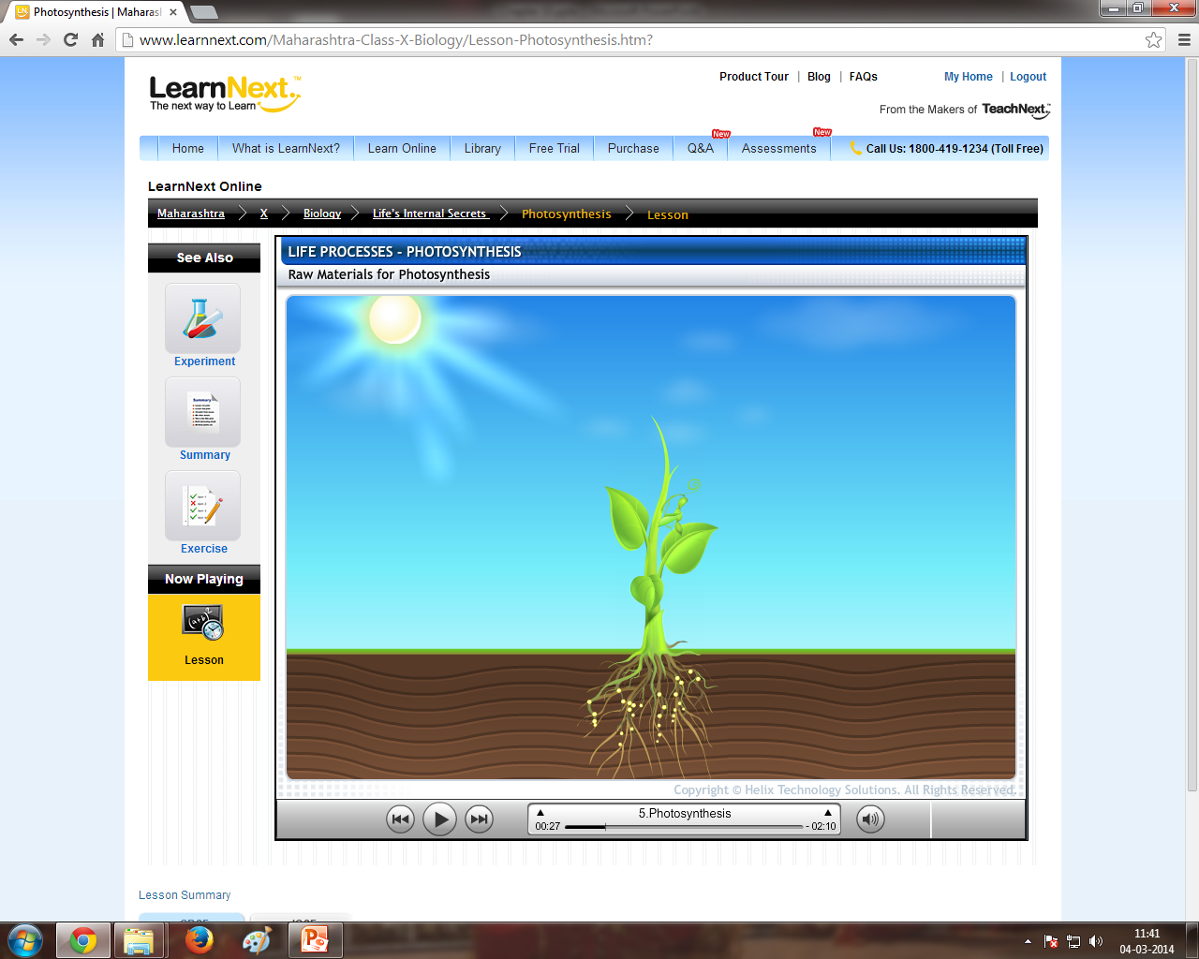
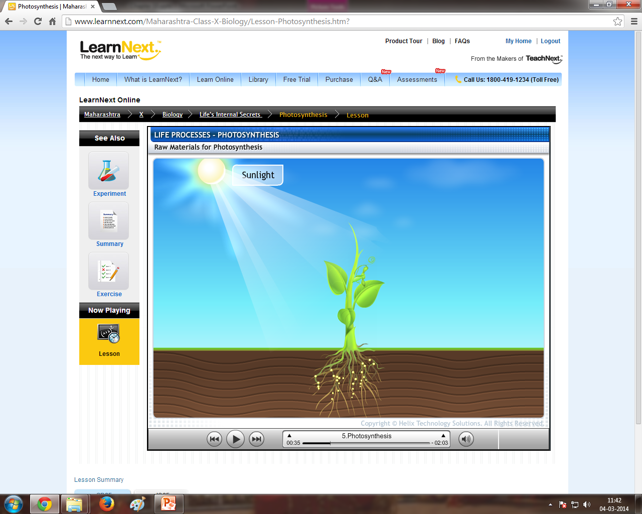

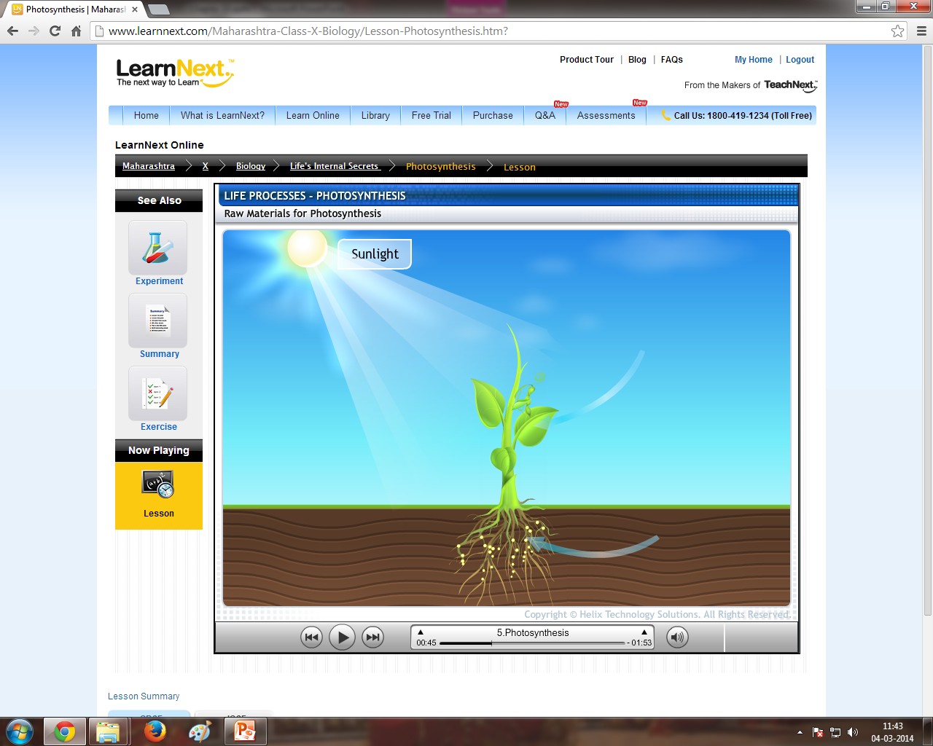
This mode of nutrition is known as
For example :
Green plants
AUTO
NUTRITION
In the presence of
SELF
CO₂
Inorganic
CO₂
By a process known as
Take in
Photosynthesis
TROPHIC
Food
(Organic)
Convert it into
And
NUTRITION
H₂O
Inorganic

Slide 4

Autotrophic nutrition is a mode of nutrition in which organisms synthesize their own organic food.
Produce
So how do we define autotrophic nutrition ?
Such organisms are called as AUTOTROPHS
e.g. Most PLANTS and some bacteria
Only green plants

Slide 5
However there are some organisms which can not prepare their own food.
They depend on other organisms for their food.
Let us see some examples :
This mode of nutrition is known as
Heterotrophic Nutrition
Hetero
trophic
Depending on others
Nutrition
Eg. All Animals and Fungi

Slide 6
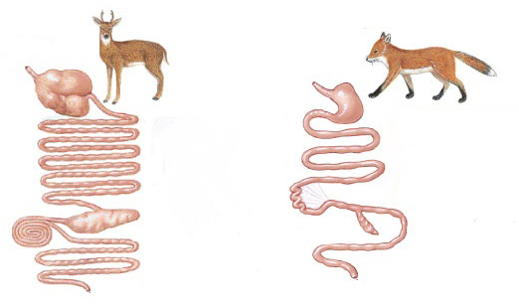
In heterotrophic Nutrition :
Methods
Different organisms use different strategies to obtain food depending upon :
Eg. Herbivores need different food compared to carnivores based on their digestive system
Depending on the type of body system
Body design
Organization
Functioning
Availability of food material
Herbivores have
For e.g.
Therefore
Carnivores have
Whether the organism is unicellular or multicellular
Depending on whether the organism is saprophytic or parasitic
Where as
Depending on what is the type of food available around the organism
Unicellular organism has different mode
Multicellular organism has different mode
Herbivores eat grass
Where as
Carnivoreseat flesh
Short intestine
Long intestine
Where as

Slide 7
Thank You

